Slide 1
JAVA - Multithreading
AMOL R PATIL - 9822291613NE

Slide 2
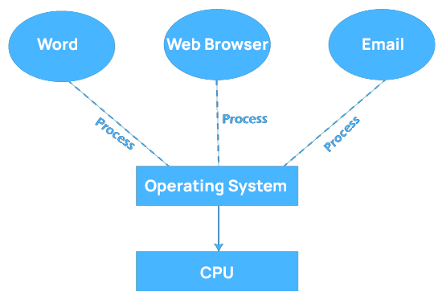
Multitasking Operating System
A multitasking operating system enables a user to perform multiple computer tasks simultaneously.
These tasks are referred to as processes, and they share processing resources such as the CPU.
The operating system maintains a record of the progress of each process and enables users to switch between them without losing any data.

Slide 3
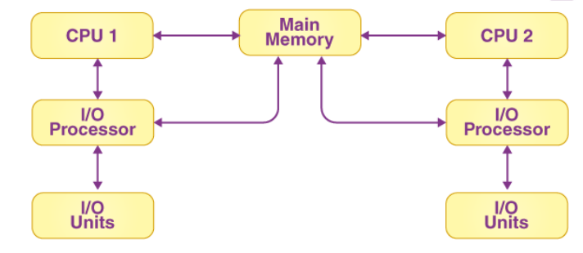
Multiprocessing Operating System
Multiprocessing helps in performing parallel computing.
There are several processors in a system, and each of them can run multiple processes simultaneously. The system’s throughput will be significantly increased as a result of this.
Parallel computing is performed by multiprocessing.
The presence of more than one processor in the system allows it to run multiple processes at the same time, increasing the system’s throughput.

Slide 4
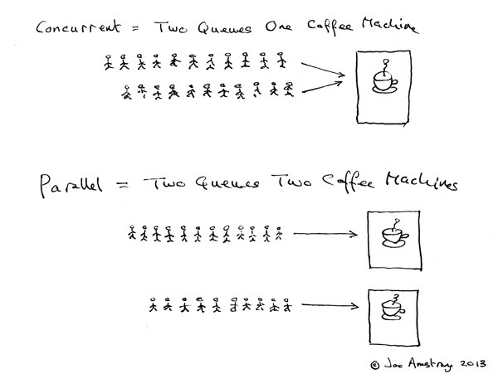
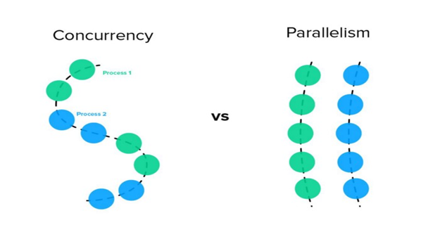
Concurrency is not Parallelism
“Concurrency is about dealing with lots of things at once. Parallelism is about doing lots of things at once.” — Rob Pike

Slide 5
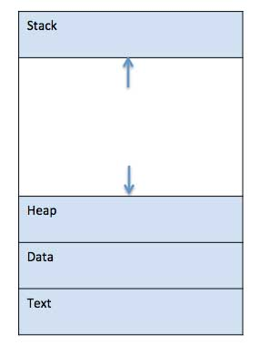
What is Process ?
A process is basically a program in execution.
When a program is loaded into the memory and it becomes a process, it can be divided into four sections ─ stack, heap, text and data
When a program is loaded into the memory and it becomes a process, it can be divided into four sections ─ stack, heap, text and data

Slide 6
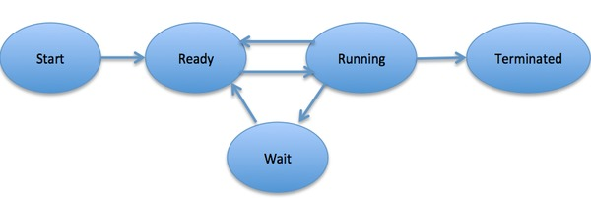
Process Life Cycle

Slide 7
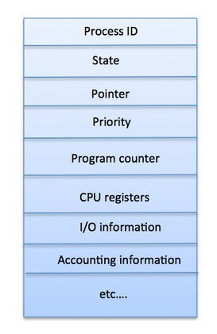
Process Control Block [ PCB ]
A Process Control Block is a data structure maintained by the Operating System for every process.
The PCB is identified by an integer process ID (PID).
A PCB keeps all the information needed to keep track of a process as listed below

Slide 8
S.N. | Information & Description
1 | Process State The current state of the process i.e., whether it is ready, running, waiting, or whatever.
2 | Process privileges This is required to allow/disallow access to system resources.
3 | Process ID Unique identification for each of the process in the operating system.
4 | Pointer A pointer to parent process.
5 | Program Counter Program Counter is a pointer to the address of the next instruction to be executed for this process.
6 | CPU registers Various CPU registers where process need to be stored for execution for running state.
7 | CPU Scheduling Information Process priority and other scheduling information which is required to schedule the process.
8 | Memory management information This includes the information of page table, memory limits, Segment table depending on memory used by the operating system.
9 | Accounting information This includes the amount of CPU used for process execution, time limits, execution ID etc.
10 | IO status information This includes a list of I/O devices allocated to the process

Slide 9
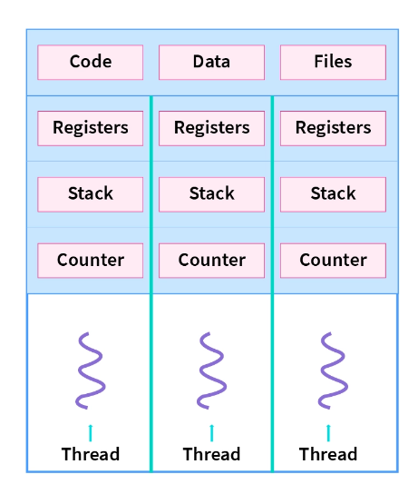
What is Thread ?
A thread of execution is the smallest sequence of programmed instructions that can be managed independently by a scheduler
A thread refers to an execution unit in the process that has its own program counter, stack, as well as a set of registers

Slide 10
Threads
A thread refers to a single sequential flow of activities being executed in a process;
it is also known as the thread of execution or the thread of control.
Now, thread execution is possible within any OS’s process. Apart from that, a process can have several threads.
A distinct program counter, a stack of activation records as well as control blocks are used by each thread of the same process. Thread is frequently described as a light technique.
The procedure can be easily broken down into numerous different threads. Multiple tabs in a browser, for example, can be considered threads. MS Word employs many threads to prepare the text in one thread, receive input in another thread, and so on.

Slide 11
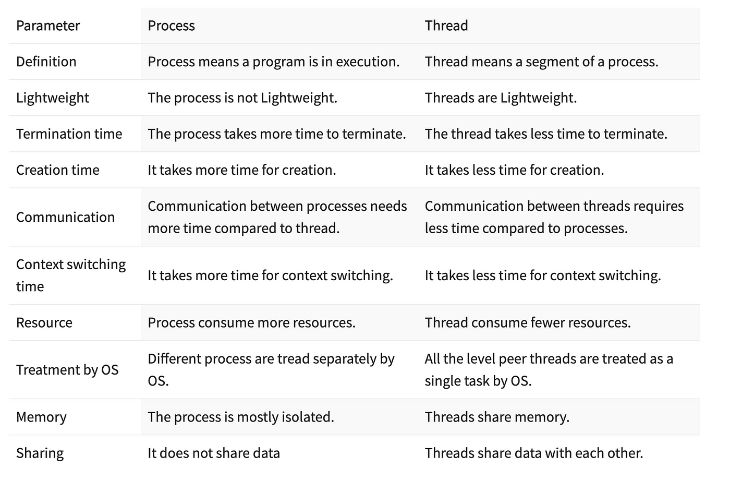

Slide 12
Multithreading and Multiprocessing
Multithreading is a technique where multiple threads are spawned by a process to do different tasks, at about the same time, just one after the other. This gives you the illusion that the threads are running in parallel, but they are actually run in a concurrent manner.
Multiprocessing is a technique where parallelism in its truest form is achieved. Multiple processes are run across multiple CPU cores, which do not share the resources among them. Each process can have many threads running in its own memory space. In Python, each process has its own instance of Python interpreter doing the job of executing the instructions.

Slide 13
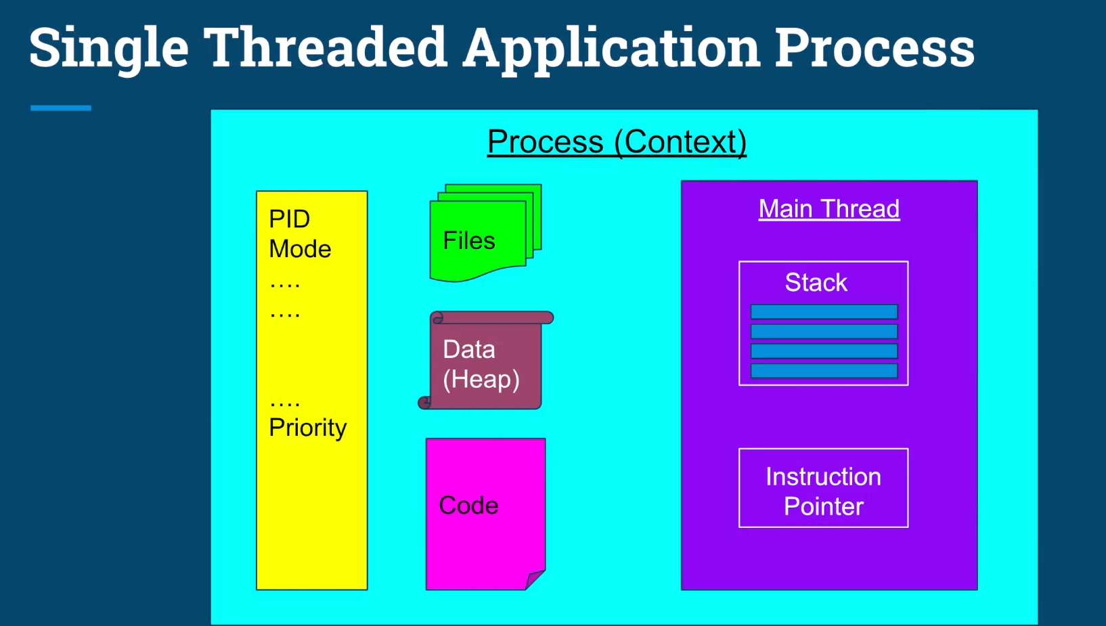

Slide 14
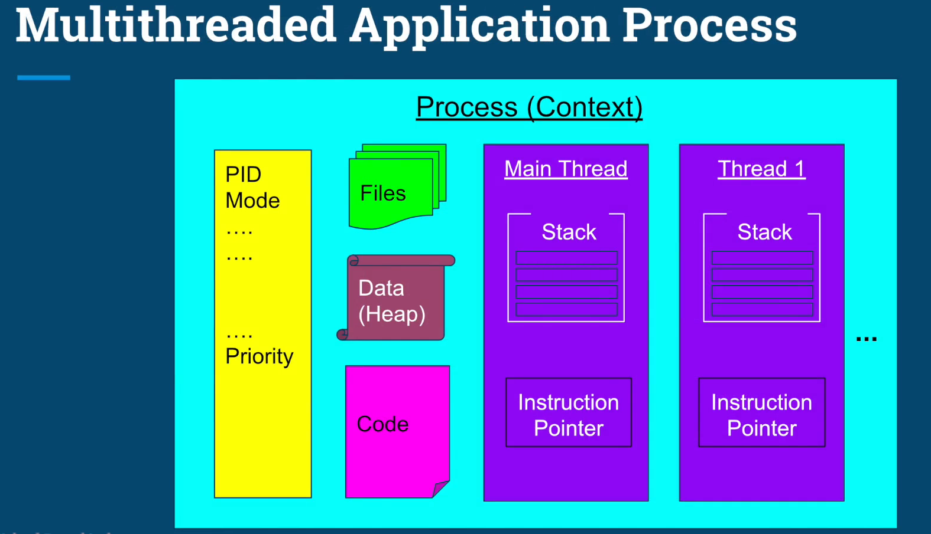

Slide 15
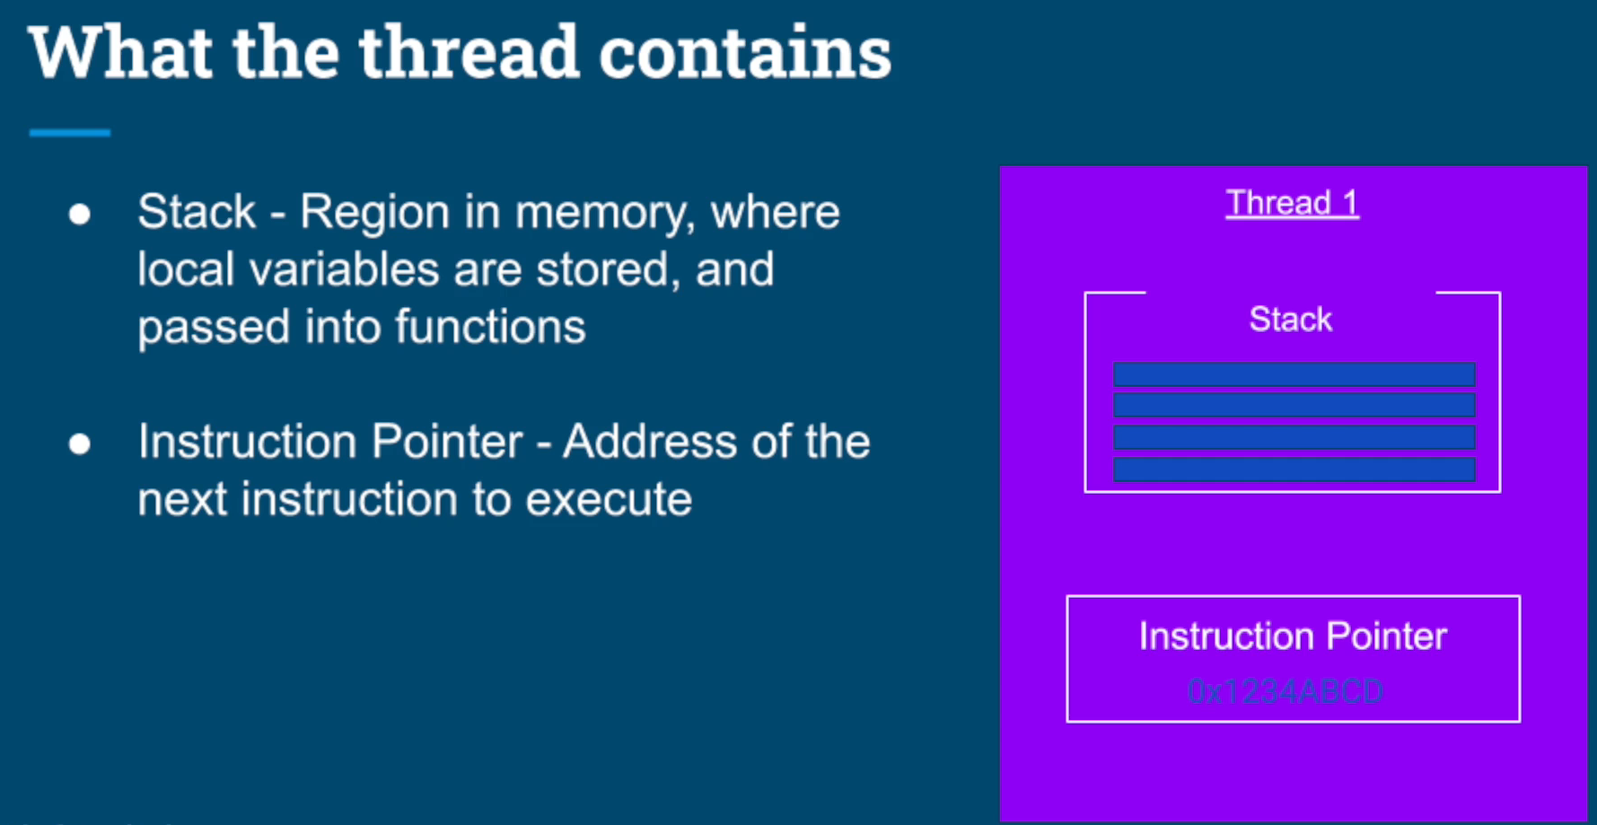

Slide 16
Creating a Thread in Java
There are two ways to create a thread:
By extending Thread class
By implementing Runnable interface.
Thread class:
Thread class provide constructors and methods to create and perform operations on a thread.Thread class extends Object class and implements Runnable interface.

Slide 17
Important Thread Methods
public void run(): is used to perform action for a thread.
public void start(): starts the execution of the thread.JVM calls the run() method on the thread.
public void sleep(long miliseconds): Causes the currently executing thread to sleep (temporarily cease execution) for the specified number of milliseconds.
public void join(): waits for a thread to die.
public void join(long miliseconds): waits for a thread to die for the specified miliseconds.
public int getPriority(): returns the priority of the thread.
public int setPriority(int priority): changes the priority of the thread.
public String getName(): returns the name of the thread.
public void setName(String name): changes the name of the thread.

Slide 18
public Thread currentThread(): returns the reference of currently executing thread.
public int getId(): returns the id of the thread.
public Thread.State getState(): returns the state of the thread.
public boolean isAlive(): tests if the thread is alive.
public void suspend(): is used to suspend the thread(depricated).
public void resume(): is used to resume the suspended thread(depricated).
public void stop(): is used to stop the thread(depricated).
public boolean isDaemon(): tests if the thread is a daemon thread.
public void setDaemon(boolean b): marks the thread as daemon or user thread.
public void interrupt(): interrupts the thread.
public boolean isInterrupted(): tests if the thread has been interrupted.
public static boolean interrupted(): tests if the current thread has been interrupted.

Slide 19
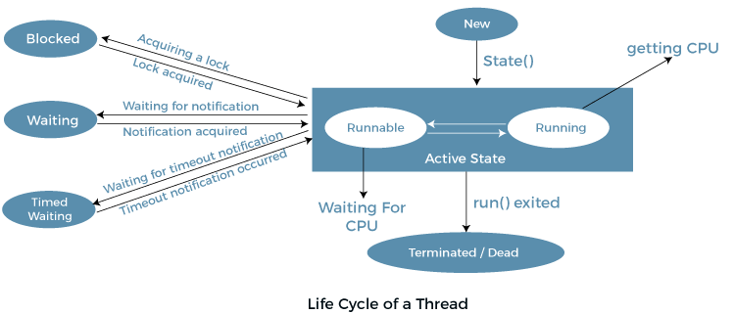

Slide 20
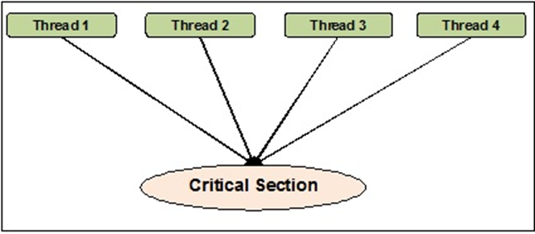
Thread Synchronization
Thread synchronization is the concurrent execution of two or more threads that share critical resources. Threads should be synchronized to avoid critical resource use conflicts.

Slide 21
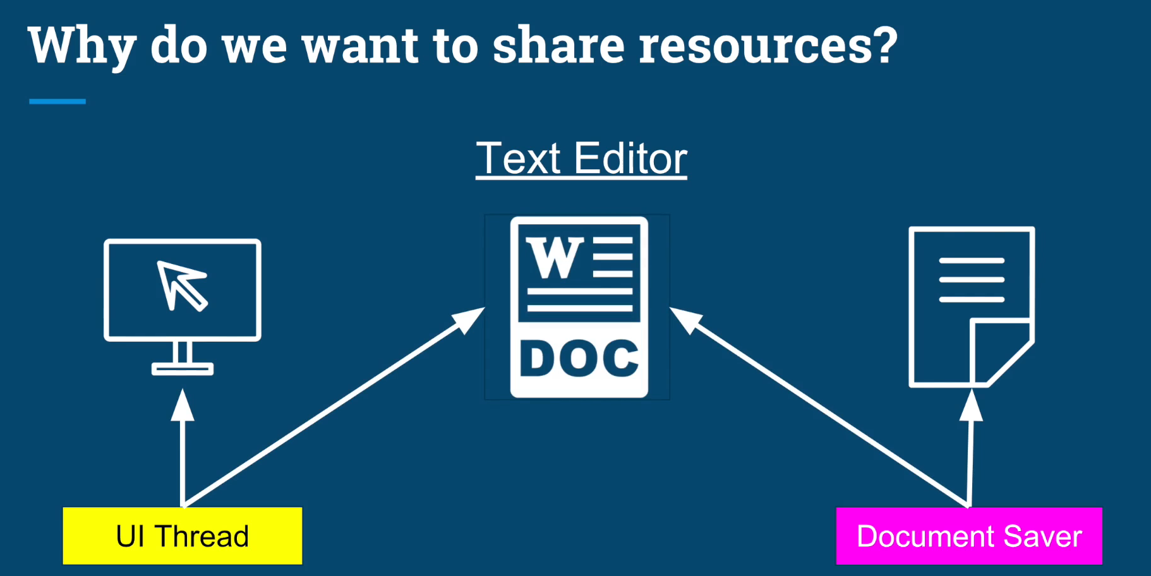

Slide 22
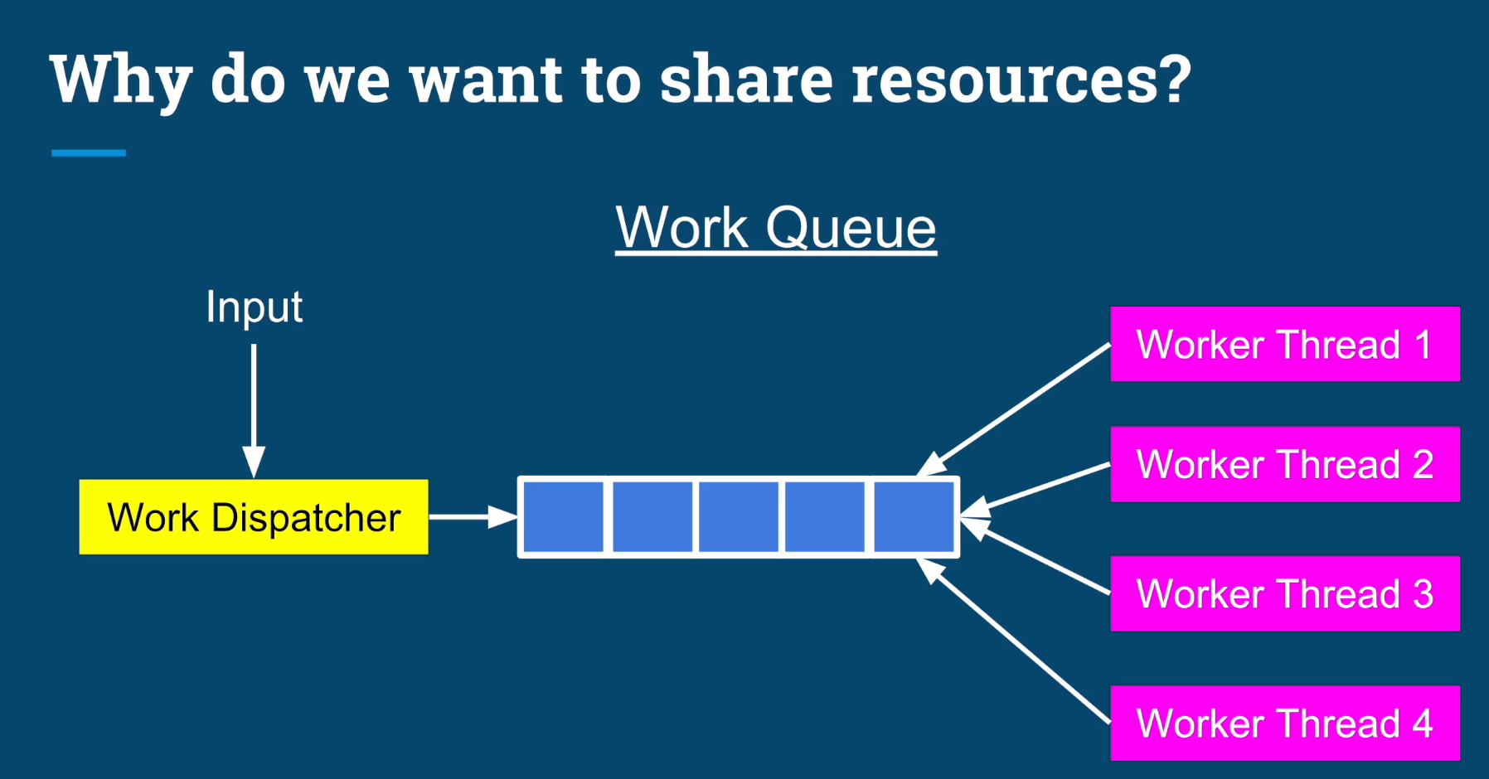

Slide 23
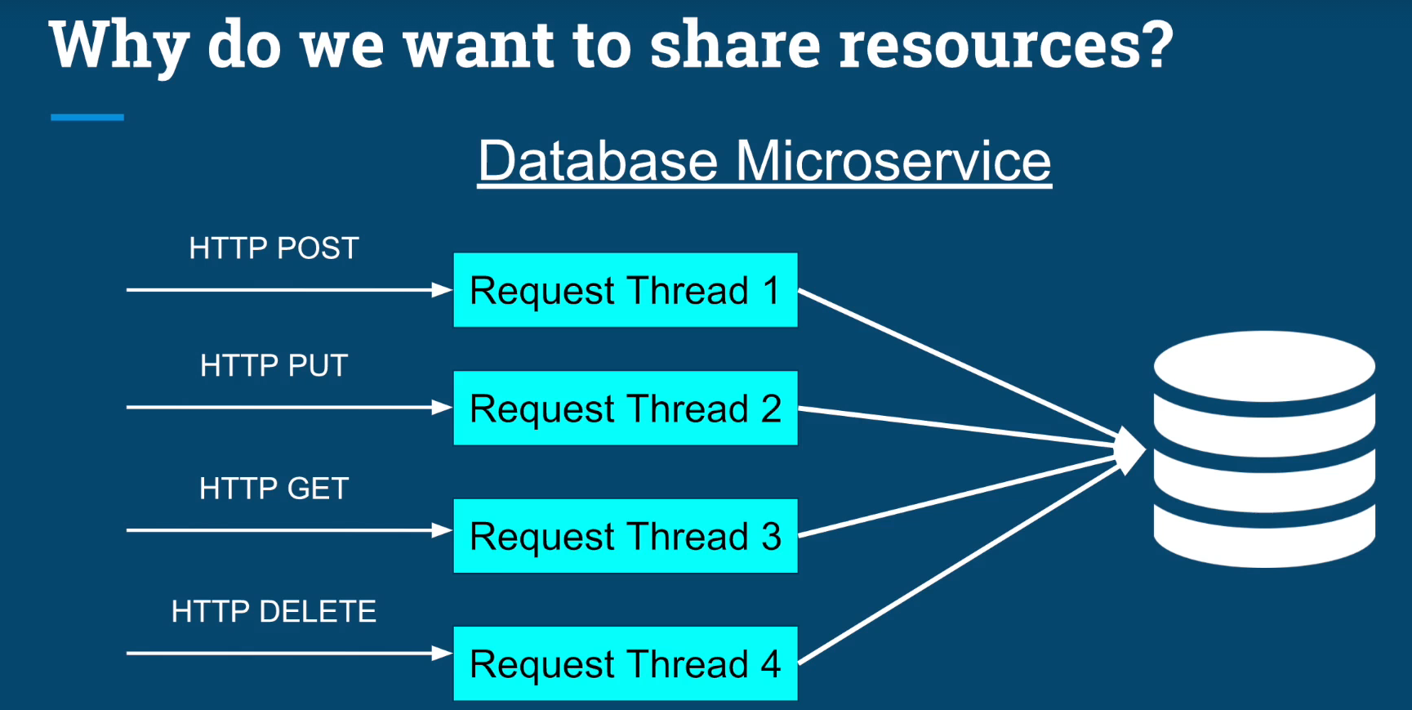

Slide 24
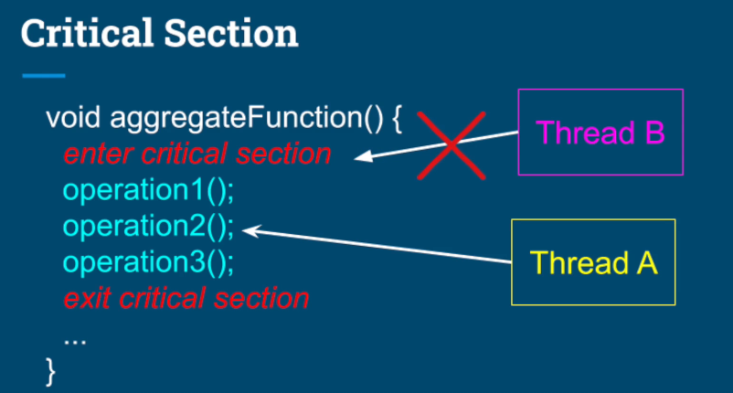

Slide 25
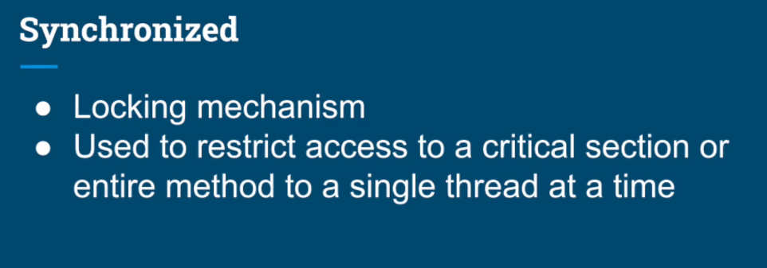

Slide 26
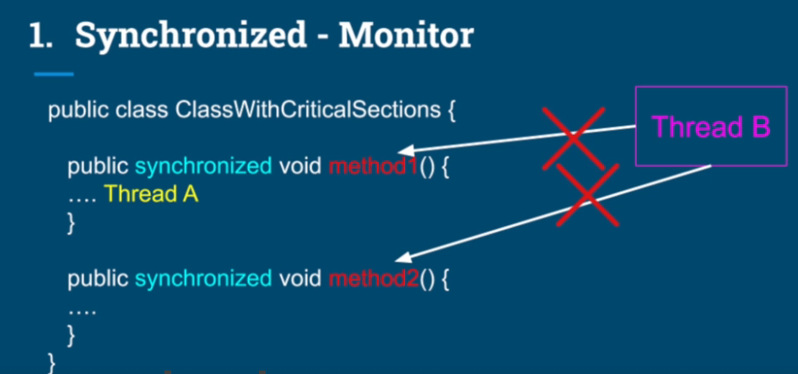

Slide 27
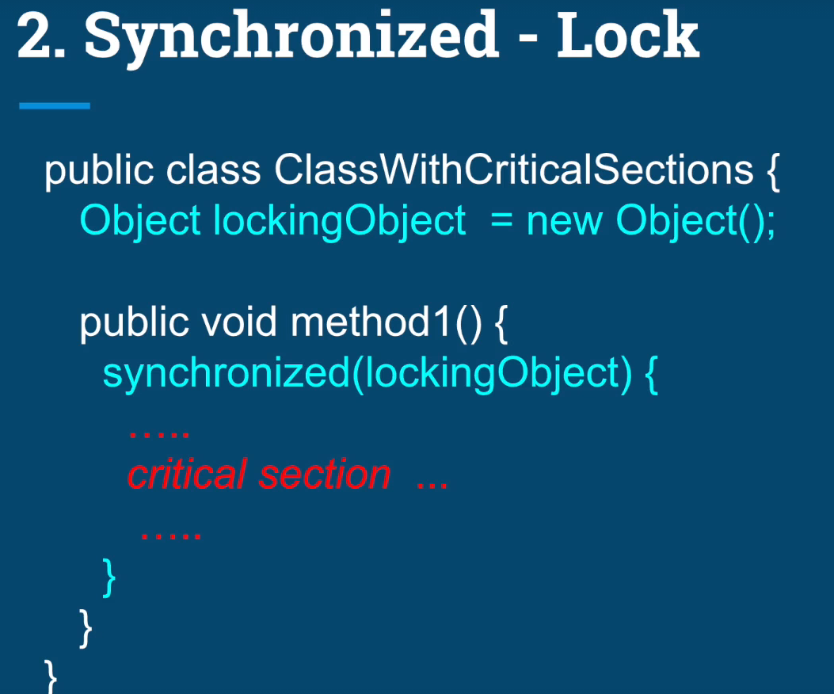

Slide 28
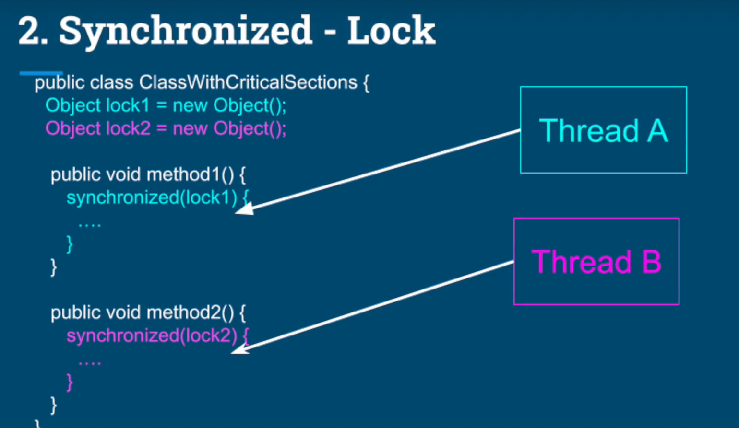

Slide 29
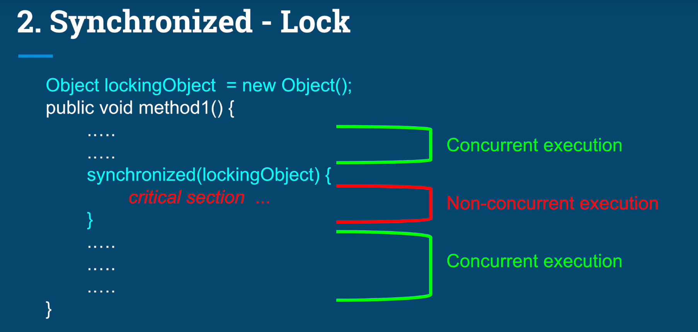

Slide 30
Race Condition
In a multi-threaded environment, when two or more threads try to update the mutually shared resource(data) at the same time, a race condition may occur because of context switching between the threads.

Slide 31
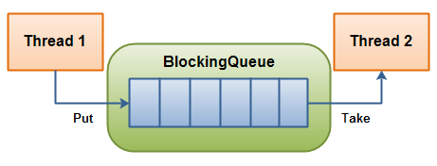
Producer Consumer Problem
In computing, the producer-consumer problem (also known as the bounded-buffer problem) is a classic example of a multi-process synchronization problem. The problem describes two processes, the producer and the consumer, which share a common, fixed-size buffer used as a queue.
The producer’s job is to generate data, put it into the buffer, and start again.
At the same time, the consumer is consuming the data (i.e. removing it from the buffer), one piece at a time.

Slide 32
Constructors
A constructor is a special method of a class or structure in object-oriented programming that initializes a newly created object of that type.
Whenever an object is created, the constructor is called automatically.
Constructors are not called explicitly and are invoked only once during their lifetime

Slide 33
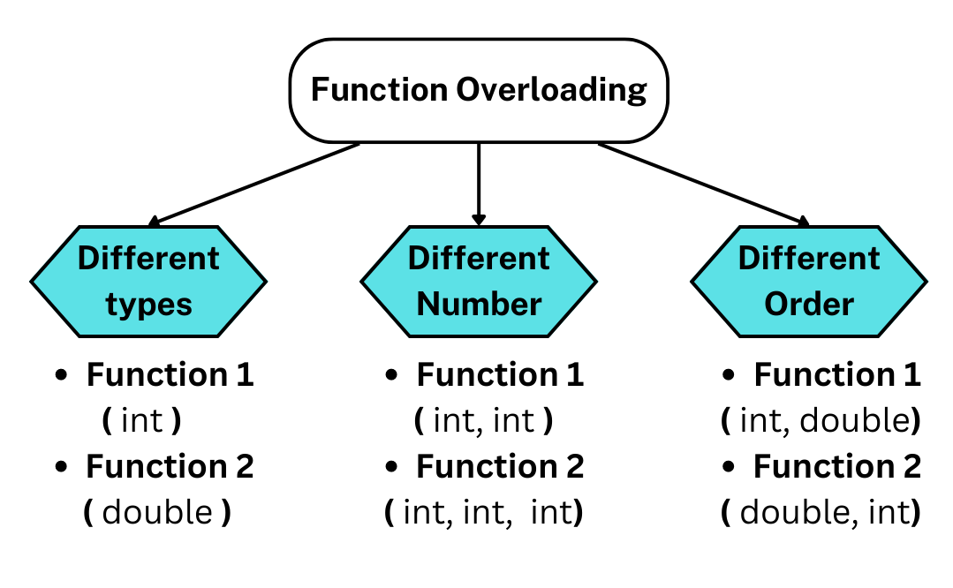
Function Overloading
Java lets you specify more than one function of the same name in the same scope. These functions are called overloaded functions, or overloads. Overloaded functions enable you to supply different semantics for a function, depending on the types and number of its arguments.

Slide 34
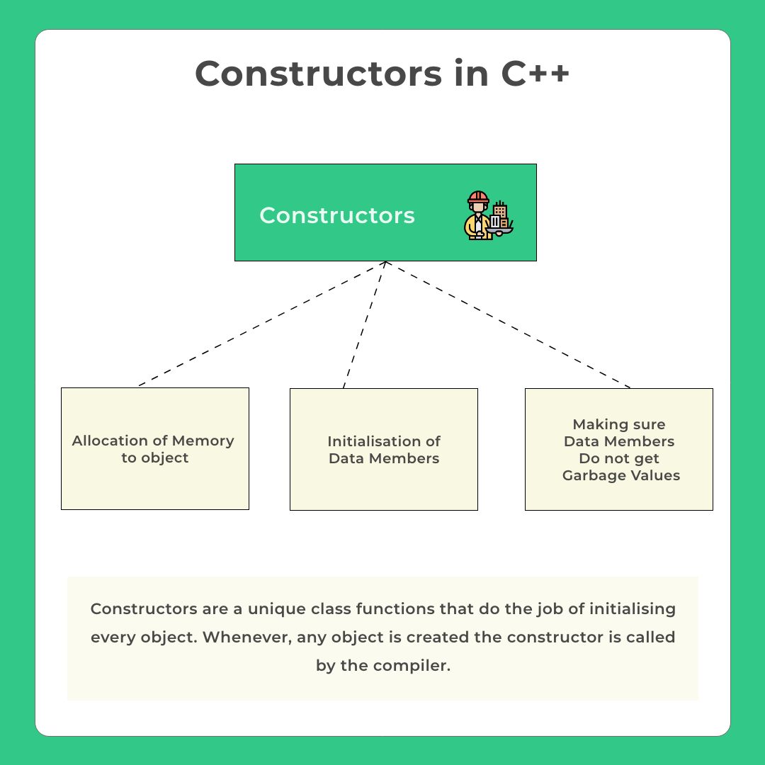

Slide 35
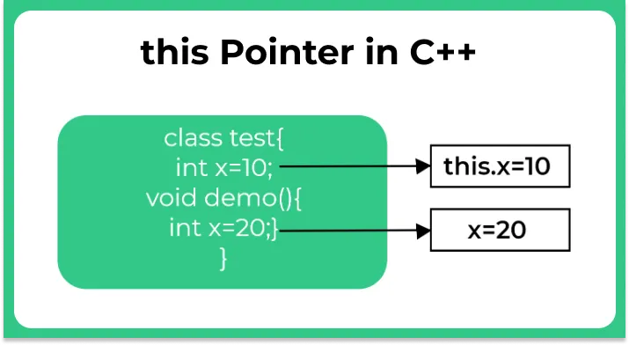
this Pointer
In C++ programming, this is a keyword that refers to the current instance of the class

Slide 36
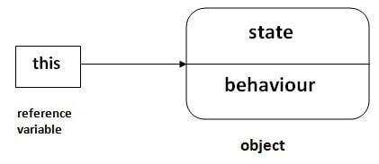
this keyword in Java
this can be used to refer current class instance variable.
this can be used to invoke current class method (implicitly)
this() can be used to invoke current class constructor.
this can be passed as an argument in the method call.
this can be passed as argument in the constructor call.
this can be used to return the current class instance from the method.

Slide 37
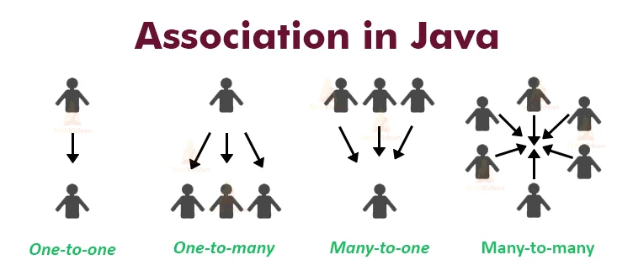
Association
Association is a relation between two separate classes which establishes through their Objects

Slide 38
Forms of Relationships
There are main forms of relationships in OOP paradigm.
IS-A (Inheritance) HAS-A (Association)
IS-A Relationship Car IS A Vehicle Cat IS AN Animal Manager IS AN Employee
All these examples denote that sub type is in the form of super type creating is-a relationship.
HAS-A Relationship Hotel HAS Rooms School HAS Departments Employee HAS Address
This represents the ownership of an entity in another. One entity belongs to another…
There are 2️⃣ forms of Association that are possible in Java:
a) Aggregation — loose coupling, weak
b) Composition — tight coupling, strong

Slide 39
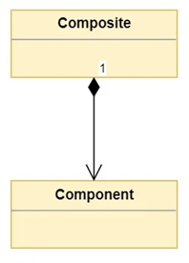
Composition
The composition means having a container object that contains other objects.
Composition is a concept that models a has a relationship. This means that a class Composite can contain an object of another class Component. This relationship means that a Composite has a Component.
Classes that contain objects of other classes are usually referred to as composites, where classes that are used to create more complex types are referred to as components

Slide 40
Aggregation
Aggregation is an association that describes “has a” relationship between objects. For example, a classroom and student are linked with “has a” relationship
Difference Between Composition & Aggregation :-
Aggregation is an association between two objects which describes the “has a” relationship while the composition is the most specific type of aggregation that implies ownership. Thus, this is the main difference between aggregation and composition.
In aggregation, destroying the owning object does not affect the containing object. However, in composition, destroying the owning object affects the containing object. Hence, this is another difference between aggregation and composition.

Slide 41
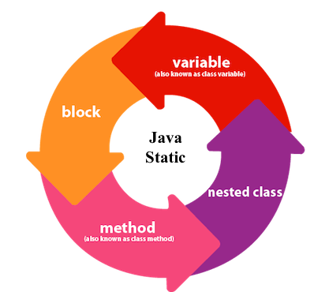
Java static members

Slide 42
static variables
Static variables defined as a class member can be accessed without object of that class. Static variable is initialized once and shared among different objects of the class. All the object of the class having static variable will have the same instance of static variable.
Static variable | Instance Variable
Represent common property | Represent unique property
Accessed using class name (can be accessed using object name as well) | Accessed using object
Allocated memory only once | Allocated new memory each time a new object is created

Slide 43
Java static method
If you apply static keyword with any method, it is known as static method.
A static method belongs to the class rather than the object of a class.
A static method can be invoked without the need for creating an instance of a class.
A static method can access static data member and can change the value of it.
Static block in Java
Static block is used to initialize static data members. Static block executes even before main() method.
It executes when the class is loaded in the memory.
A class can have multiple Static blocks, which will execute in the same sequence in which they are programmed

Slide 44
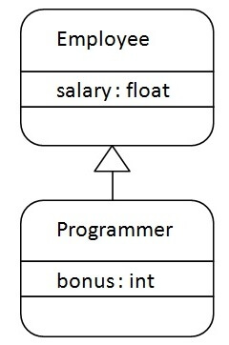
Inheritance in Java
Inheritance in Java is a mechanism in which one object acquires all the properties and behaviors of a parent object. It is an important part of OOPs (Object Oriented programming system).
The idea behind inheritance in Java is that you can create new classes that are built upon existing classes. When you inherit from an existing class, you can reuse methods and fields of the parent class. Moreover, you can add new methods and fields in your current class also.
Inheritance represents the IS-A relationship which is also known as a
parent-child relationship.

Slide 45
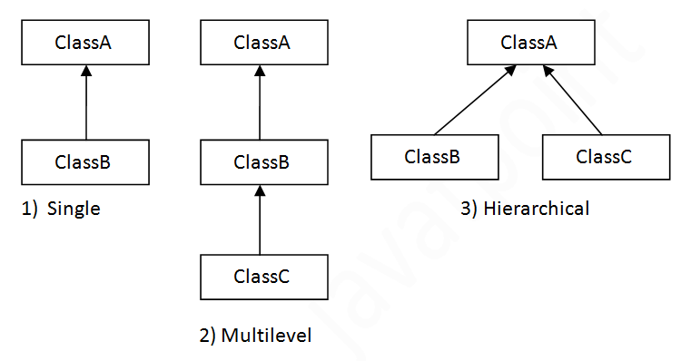
Types of Inheritances

Slide 46
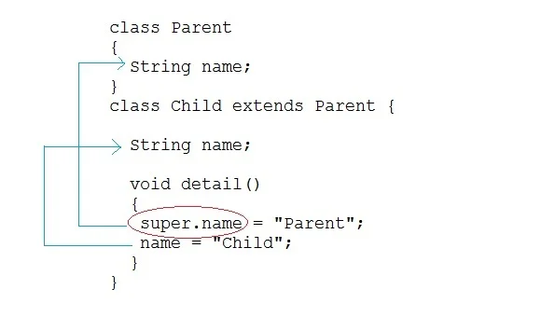
super keyword
In Java, super keyword is used to refer to immediate parent class of a child class. In other words super keyword is used by a subclass whenever it need to refer to its immediate super class.

Slide 47
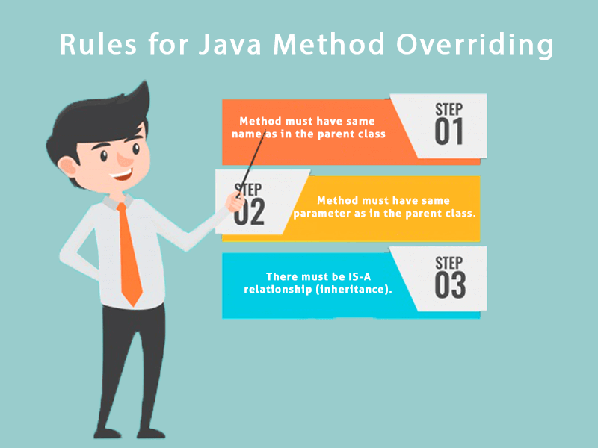
Method Overriding
If subclass (child class) has the same method as declared in the parent class, it is known as method overriding in Java.

Slide 48
Method Overriding
When we override a method, it's recommended to put @Override, immediately above the method definition.
The @Override statement is not required, but it's a way to get the compiler to flag an error, if you don't actually properly override this method.
We'll get an error, if we don't follow the overriding rules correctly.
We can't override static methods, only instance methods can be overridden

Slide 49
Method Overriding Rules
A method will be considered overridden, if we follow these rules.
It must have the same name and same arguments.
The return type can be a subclass of the return type in the parent class.
It can't have a lower access modifier. In other words, it can't have more restrictive access privileges.
For example, if the parent's method is protected, then using private in the child's overridden method is not allowed. However, using public for the child's method would be allowed, in this example.

Slide 50
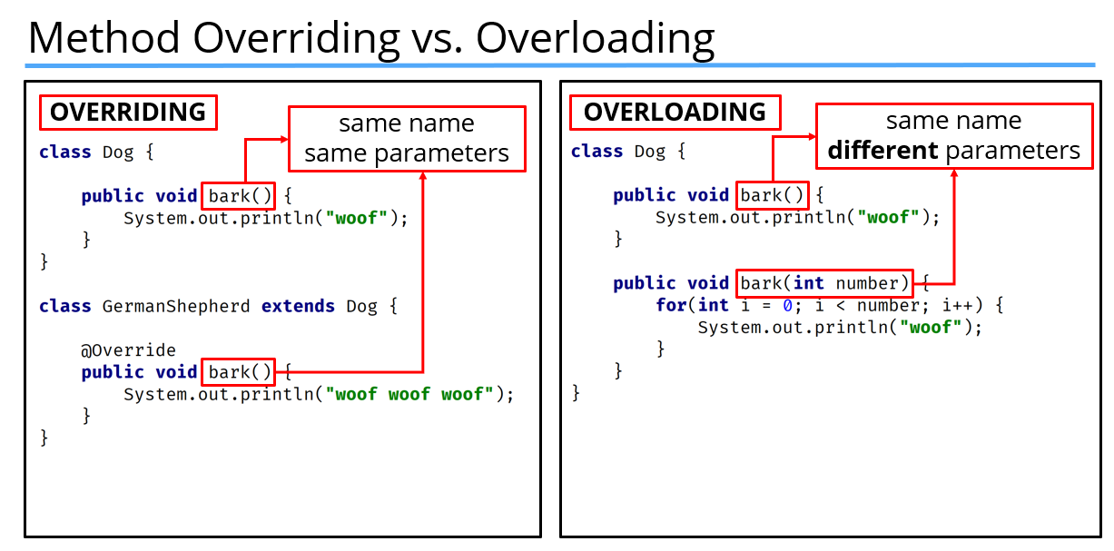

Slide 51
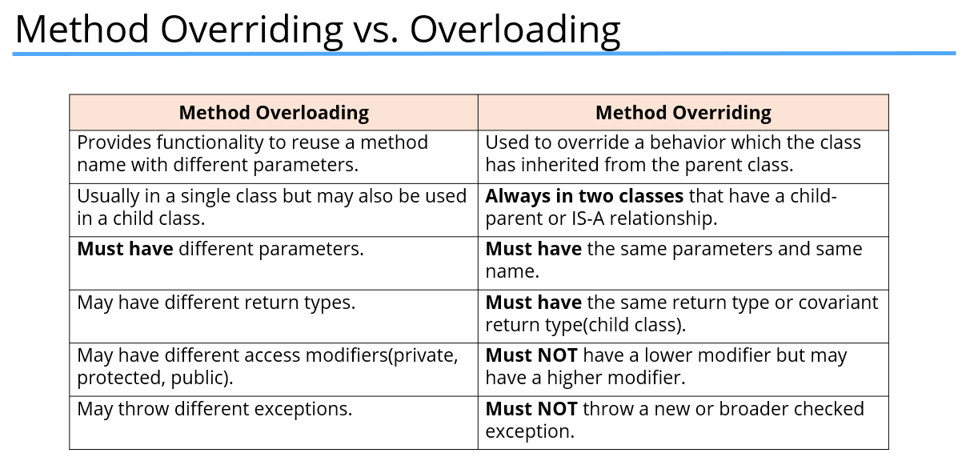

Slide 52
final modifier
Final modifier is used to declare a field as final. It can be used with variable, method or a class.
If we declare a variable as final then it prevents its content from being modified. The variable acts like a constant. Final field must be initialized when it is declared. Final variable that is not initialized at the time of declaration is called blank final variable. Java allows to declare a final variable without initialization but it should be initialized by the constructor only
If we declare a method as final then it prevents it from being overridden.
If we declare a class as final the it prevents from being inherited. We can not inherit final class in Java.

Slide 53
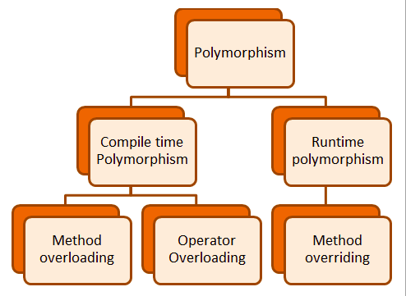

Slide 54
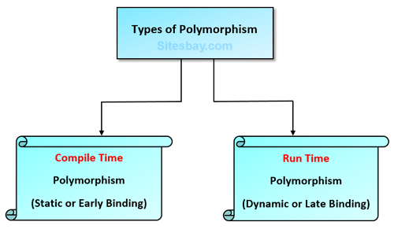

Slide 55
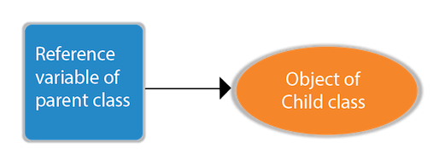
Dynamic Polymorphism
Runtime polymorphism or Dynamic Method Dispatch is a process in which a call to an overridden method is resolved at runtime rather than compile-time.

Slide 56
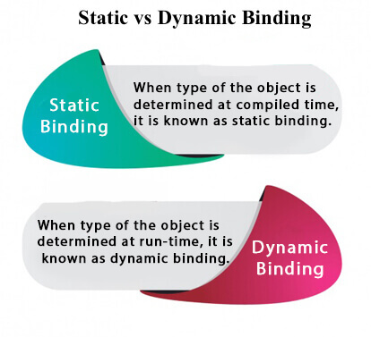
static binding and dynamic binding
Connecting a method call to the method body is known as binding.
There are two types of binding
Static Binding (also known as Early Binding).
Dynamic Binding (also known as Late Binding).

Slide 57
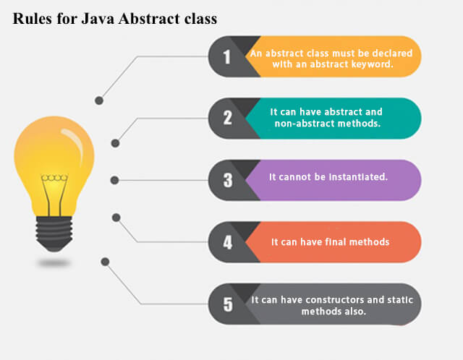
Abstract class
Abstraction is a process of hiding the implementation details and showing only functionality to the user.
A class which is declared using abstract keyword known as abstract class. An abstract class may or may not have abstract methods. We cannot create object of abstract class.

Slide 58
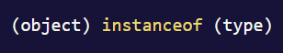
instance of operator
In Java, instanceof is an operator which is used to check object reference. It checks whether the reference of an object belongs to the provided type or not. It returns either true or false, if an object reference is of specified type then it return true otherwise false.

Slide 59
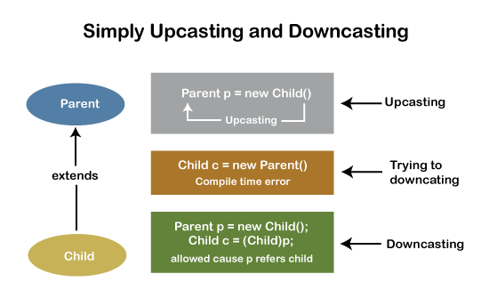
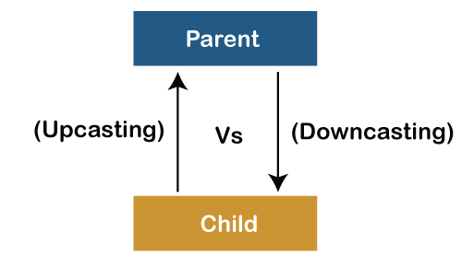
Downcasting and Upcasting

Slide 60
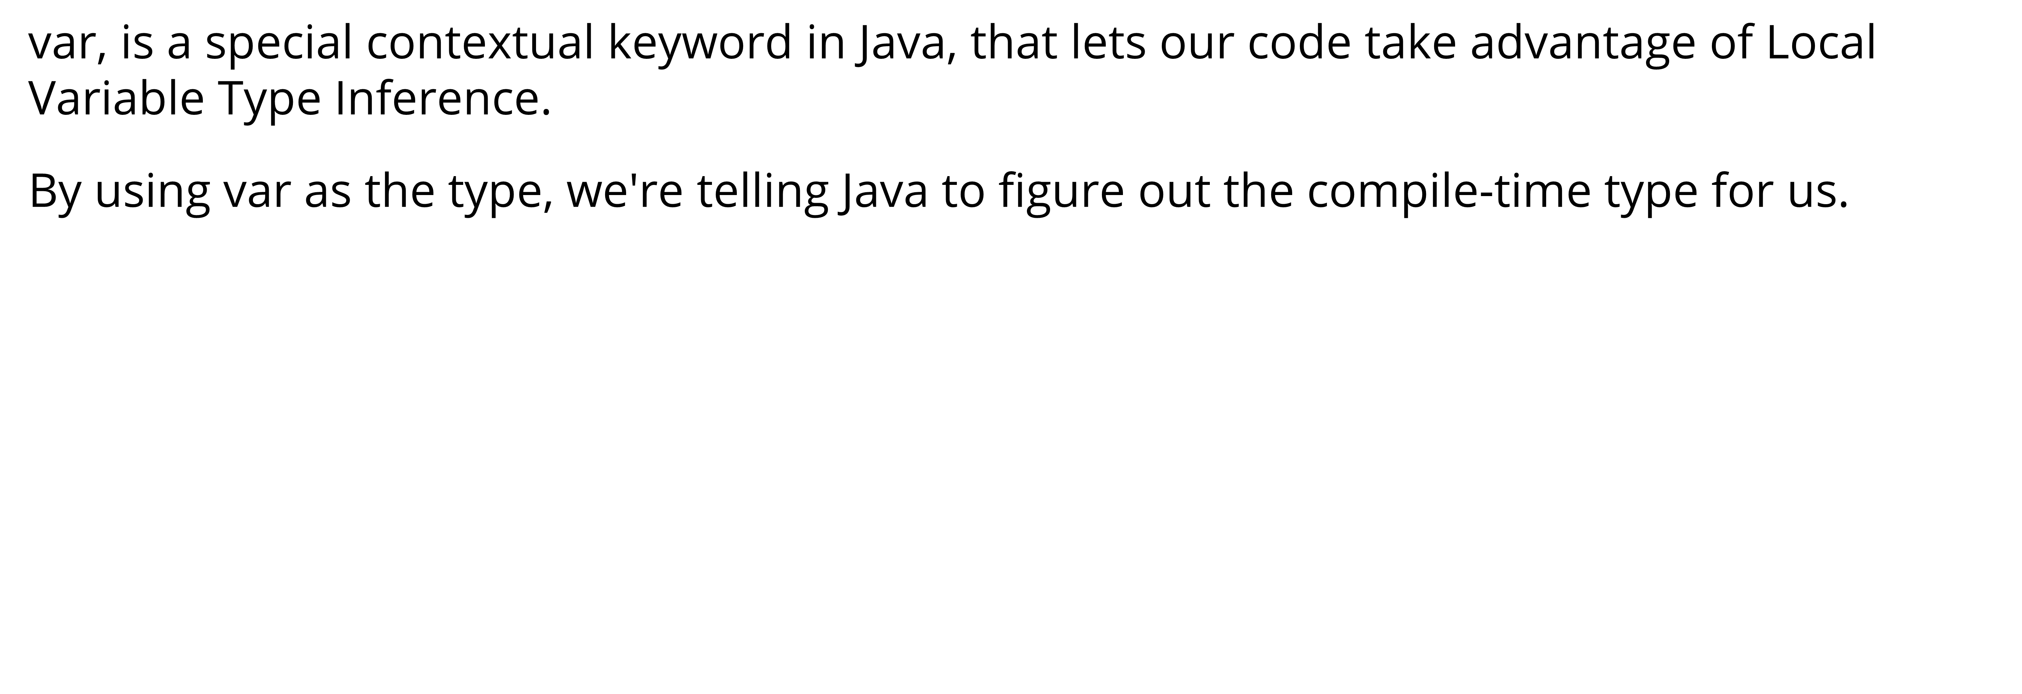
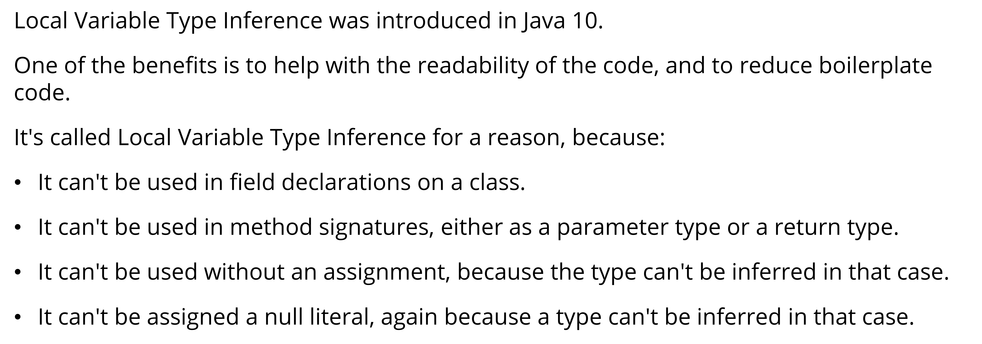
var type

Slide 61
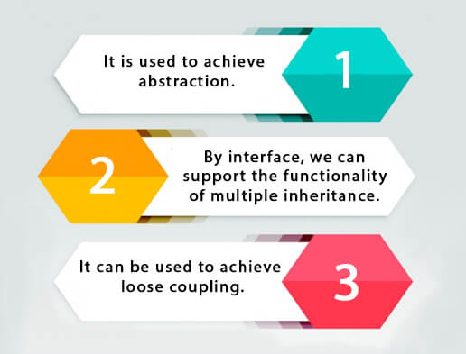
Java Interfaces
An interface in Java is a blueprint of a class. It has static constants and abstract methods.
The interface in Java is a mechanism to achieve abstraction. There can be only abstract methods in the Java interface, not method body. It is used to achieve abstraction and multiple inheritance in Java.
Since Java 8, we can have default and static methods in an interface.
Since Java 9, we can have private methods in an interface.

Slide 62
Purpose of Java Interfaces
An interface in Java is a specification of method prototypes. Whenever you need to guide the programmer or, make a contract specifying how the methods and fields of a type should be you can define an interface
Multiple inheritance − Java doesn’t support multiple inheritance, using interfaces you can achieve multiple inheritance −
Abstraction − Abstraction is a process of hiding the implementation details from the user, only the functionality will be provided to the user. In other words, the user will have the information on what the object does instead of how it does it.
Since all the methods of the interface are abstract and user doesn’t know how a method is written except the method signature/prototype. Using interfaces, you can achieve (complete) abstraction.
Loose coupling − Coupling refers to the dependency of one object type on another, if two objects are completely independent of each other and the changes done in one doesn’t affect the other both are said to be loosely coupled.
You can achieve loose coupling in Java using interfaces −

Slide 63
Default Methods in Interface
With the release of Java 8, we can now add methods with implementation inside an interface. These methods are called default methods.
public default void getSides() {
// body of getSides()
}
The Java 8 also added another feature to include static methods inside an interface.
With the release of Java 9, private methods are also supported in interfaces. private methods are used as helper methods that provide support to other methods in interfaces.

Slide 64
Functional Interface
An Interface that contains exactly one abstract method is known as functional interface. It can have any number of default, static methods but can contain only one abstract method.
Functional Interface is also known as Single Abstract Method Interfaces or SAM Interfaces
Runnable, ActionListener, and Comparable are some of the examples of functional interfaces.
Functional interfaces are used and executed by representing the interface with an annotation called @FunctionalInterface.

Slide 65
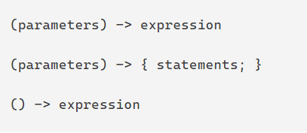
Lambda Expression
Lambda Expression is an anonymous (nameless) function. In other words, the function which doesn’t have the name, return type and access modifiers. Lambda Expression is also known as anonymous functions or closures.
The primary Objective of introducing Lambda Expression is to promote the benefits of functional programming in Java

Slide 66
Abstract class vs. Interface
Abstract class | Interface
Abstract class is a class which contain one or more abstract methods, which has to be implemented by its sub classes. | Interface is a Java Object containing method declaration but no implementation. The classes which implement the Interfaces must provide the method definition for all the methods.
Abstract class is a Class prefix with an abstract keyword followed by Class definition. | Interface is a pure abstract class which starts with interface keyword.
Abstract class can also contain concrete methods. | Whereas, Interface contains all abstract methods and final variable declarations.
Abstract classes are useful in a situation that Some general methods should be implemented and specialization behavior should be implemented by child classes. | Interfaces are useful in a situation that all properties should be implemented.

Slide 67
Nested classes
Java inner class or nested class is a class that is declared inside the class or interface.
We use inner classes to logically group classes and interfaces in one place to be more readable and maintainable.
Additionally, it can access all the members of the outer class, including private data members and methods.
There are two types of nested classes you can create in Java.
Non-static nested class (inner class)
Static nested class

Slide 68
Nested classes
Type | Description
Member Inner Class | A class created within class and outside method.
Anonymous Inner Class | A class created for implementing an interface or extending class. The java compiler decides its name.
Local Inner Class | A class was created within the method.
Static Nested Class | A static class was created within the class.
Nested Interface | An interface created within class or interface.

Slide 69
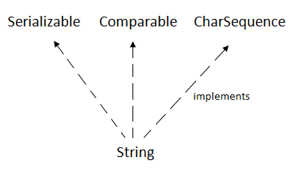

Java Strings
String is Sequence of Characters represented as an Object
The Java String is immutable which means it cannot be changed. Whenever we change any string, a new instance is created.
For mutable strings, you can use StringBuffer and StringBuilder classes.

Slide 70

String Pool
All Strings are stored in the String Pool (or String Intern Pool) that is allocated in the Java heap.
String pool is an implementation of the String Interring Concept.
String Interning is a method that stores only a copy of each distinct string literal.
The distinct values are stored in the String pool.
String pool is an example of the Flyweight Design Pattern

Slide 71


Slide 72


Slide 73
Java Object class
The Object class is the parent class of all the classes in java by default. In other words, it is the topmost class of java.
Java Object getClass() returns the class name of the object
Java Object hashCode() returns the hashcode value of the object
Java Object toString() converts an object into the string
Java Object equals() checks if two objects are equal
Java Object clone() creates a copy of the object

Slide 74

Java Wrapper Classes

Slide 75
Java Exception
An expectation is an unexpected event that occurs while executing the program, that disturbs the normal flow of the code
. It can occur for various reasons say-
A user has entered an invalid data
File not found
A network connection has been lost in the middle of communications
The JVM has run out of a memory

Slide 76
Exception Handling
The Exception Handling in Java is a mechanism using which the normal flow of the application is maintained. To do this, we employ a powerful mechanism to handle runtime errors or exceptions in a program.
Java exception handling provides a meaningful message to the user about the issue rather than a system generated message, which may not be understandable to a user

Slide 77

Exception Hierarchy

Slide 78
Types of Exceptions
Checked Exception
These are the exceptions that are checked at compile time. If some code within a method throws a checked exception, then the method must either handle the exception or it must specify the exception using the throws keyword.
Unchecked Exception
These are the exceptions that are not checked at compile time.

Slide 79
Program on Loops
Count of prime no’s in given range
2. WAP to generate the max number using the digits of entered number
4936 --> 9643
3. Enter the number and add the alternate digit from it.
no=28416 ==> 6+4+2 = 12
1+8 = 9
4. Write a program to print the Floyd's Triangle.
1
01
101
0101
10101

Slide 80
Program on Arrays
1. Write a program to find second largest element in an array.
2. Write a program to count frequency of each element in an array.
3. Write a program to print all unique elements in the array.
4. Write a program to count total number of duplicate elements in an array.

Slide 81
Inheritance
Design and develop inheritance for a given case study, identify objects and relationships
and implement inheritance wherever applicable.
Employee class has Emp_name, Emp_id,
Address, Mail_id, and Mobile_no as members. Inherit the classes: Programmer, Team Lead, Assistant Project Manager and Project Manager from employee class.
Add Basic Pay (BP) as
the member of all the inherited classes . with 97% of BP as DA, 10 % of BP as HRA, 12% of
BP as PF, 0.1% of BP for staff club fund. Generate pay slips for the employees with their
gross and net salary

Slide 82


Slide 83


Slide 84
Leap Year Calculator – Method Ex.
Write a method isLeapYear with a parameter of type int named year.
The parameter needs to be greater than or equal to 1 and less than or equal to 9999.
If the parameter is not in that range return false.
Otherwise, if it is in the valid range, calculate if the year is a leap year and return true if it is a leap year, otherwise return false.
To determine whether a year is a leap year, follow these steps:
1. If the year is evenly divisible by 4, go to step 2. Otherwise, go to step 5.
2. If the year is evenly divisible by 100, go to step 3. Otherwise, go to step 4.
3. If the year is evenly divisible by 400, go to step 4. Otherwise, go to step 5.
4. The year is a leap year (it has 366 days). The method isLeapYear needs to return true.
5. The year is not a leap year (it has 365 days). The method isLeapYear needs to return false.
The following years are not leap years:
1700, 1800, 1900, 2100, 2200, 2300, 2500, 2600
This is because they are evenly divisible by 100 but not by 400.

Slide 85
The following years are leap years:
1600, 2000, 2400
This is because they are evenly divisible by both 100 and 400.
Examples of input/output:
isLeapYear(-1600); → should return false since the parameter is not in range (1-9999)
isLeapYear(1600); → should return true since 1600 is a leap year
isLeapYear(2017); → should return false since 2017 is not a leap year
isLeapYear(2000); → should return true because 2000 is a leap year

Slide 86
DecimalComparator Method-Ex
Write a method areEqualByThreeDecimalPlaces with two parameters of type double.
The method should return boolean and it needs to return true if two double numbers are the same up to three decimal places. Otherwise, return false.
EXAMPLES OF INPUT/OUTPUT:
areEqualByThreeDecimalPlaces(-3.1756, -3.175); → should return true since numbers are equal up to 3 decimal places.
areEqualByThreeDecimalPlaces(3.175, 3.176); → should return false since numbers are not equal up to 3 decimal places
areEqualByThreeDecimalPlaces(3.0, 3.0); → should return true since numbers are equal up to 3 decimal places.
areEqualByThreeDecimalPlaces(-3.123, 3.123); → should return false since numbers are not equal up to 3 decimal places.

Slide 87


Slide 88
Sum Calculator – class and object ex.
Write a class with the name SimpleCalculator. The class needs two fields (instance variables) with names firstNumber and secondNumber both of type double.
SimpleCalculator calculator = new SimpleCalculator();
calculator.setFirstNumber(5.0);
calculator.setSecondNumber(4);
System.out.println("add= " + calculator.getAdditionResult());
System.out.println("subtract= " + calculator.getSubtractionResult());
calculator.setFirstNumber(5.25);
calculator.setSecondNumber(0);
System.out.println("multiply= " + calculator.getMultiplicationResult());
System.out.println("divide= " + calculator.getDivisionResult());

Slide 89
Rectangle – class and object ex.
Write a class with the name Rectangle. The class needs two fields (instance variables) with names length and width both of type double.
Rectangle r=new Rectangle();
r.setLength(10.5);//check with negative values.
r.setBreadth(5.5);
System.out.println("Area "+r.area());
System.out.println("Perimeter "+r.perimeter());
System.out.println("Is Square "+r.isSquare());
System.out.println("Length "+r.getLength());
System.out.println("Breadth "+r.getBreadth());

Slide 90
Cylinder – class and object ex.
Write a class with the name Cylinder. The class needs two fields (instance variables) with names radius and height both of type double.
Cylinder c=new Cylinder();
c.setHeight(10);
c.setRadius(7);
c.setDimensions(10, 7);
System.out.println("LidArea "+c.lidArea());
System.out.println("Circumference "+c.perimeter());
System.out.println("totalSurfaceArea "+c.drumArea());
System.out.println("Volume "+c.volume());
System.out.println("Height"+c.getHeight());
System.out.println("Radius"+c.getRadius());

Slide 91
Point - Constructor
You have to represent a point in 2D space. Write a class with the name Point. The class needs two fields (instance variables) with name x and y of type int.
The class needs to have two constructors. The first constructor does not have any parameters (no-arg constructor). The second constructor has parameters x and y of type int and it needs to initialize the fields.
To find a distance between points A(xA,yA) and B(xB,yB), we use the formula:
d(A,B)=√ (xB − xA) * (xB - xA) + (yB − yA) * (yB - yA)
Point first = new Point(6, 5);
Point second = new Point(3, 1);
System.out.println("distance(0,0)= " + first.distance());
System.out.println("distance(second)= " + first.distance(second));
System.out.println("distance(2,2)= " + first.distance(2, 2));
Point point = new Point();
System.out.println("distance()= " + point.distance());
Use Math.sqrt to calculate the square root √.

Slide 92
Composition
Class Customer : ID , Name , Gender, Age
Class Account : accountNo , Customer, balance
Account account = new Account(1, new Customer(2, “Rohit", ‘m’ , 45) ,10000.0);
System.out.println(account);
account.withdraw(100);
System.out.println(account);
System.out.println(account.getCustomerName());
account.deposit(500);
System.out.println(account);

Slide 93
Composition
Point class : X , Y with constructor and getter , setter methods
double distance(int x, int y)
double distance(Point another)
double distance() -- from 0,0
Circle class : Point center, int radius
Circle myCircle = new Circle(new Point(5, 8), 6);
System.out.println(myCircle.distance(new Circle(new Point(30,46),2)));
System.out.println(myCircle.getArea());
System.out.println(myCircle.getCircumference());

Slide 94
Write a class with the name Circle. The class needs one field (instance variable) with name radius of type double.
The class needs to have one constructor with parameter radius of type double and it needs to initialize the fields.
In case the radius parameter is less than 0 it needs to set the radius field value to 0.
Write the following methods (instance methods):
Method named getRadius without any parameters, it needs to return the value of radius field.
Method named getArea without any parameters, it needs to return the calculated area (radius * radius * PI). For PI use Math.PI constant.

Slide 95
Write a class with the name Cylinder that extends Circle class. The class needs one field (instance variable) with name height of type double.
The class needs to have one constructor with two parameters radius and height both of type double. It needs to call parent constructor and initialize a height field.
In case the height parameter is less than 0 it needs to set the height field value to 0.
Write the following methods (instance methods):
Method named getHeight without any parameters, it needs to return the value of height field.
Method named getVolume without any parameters, it needs to return the calculated volume. To calculate volume multiply the area with height.

